Slide 1
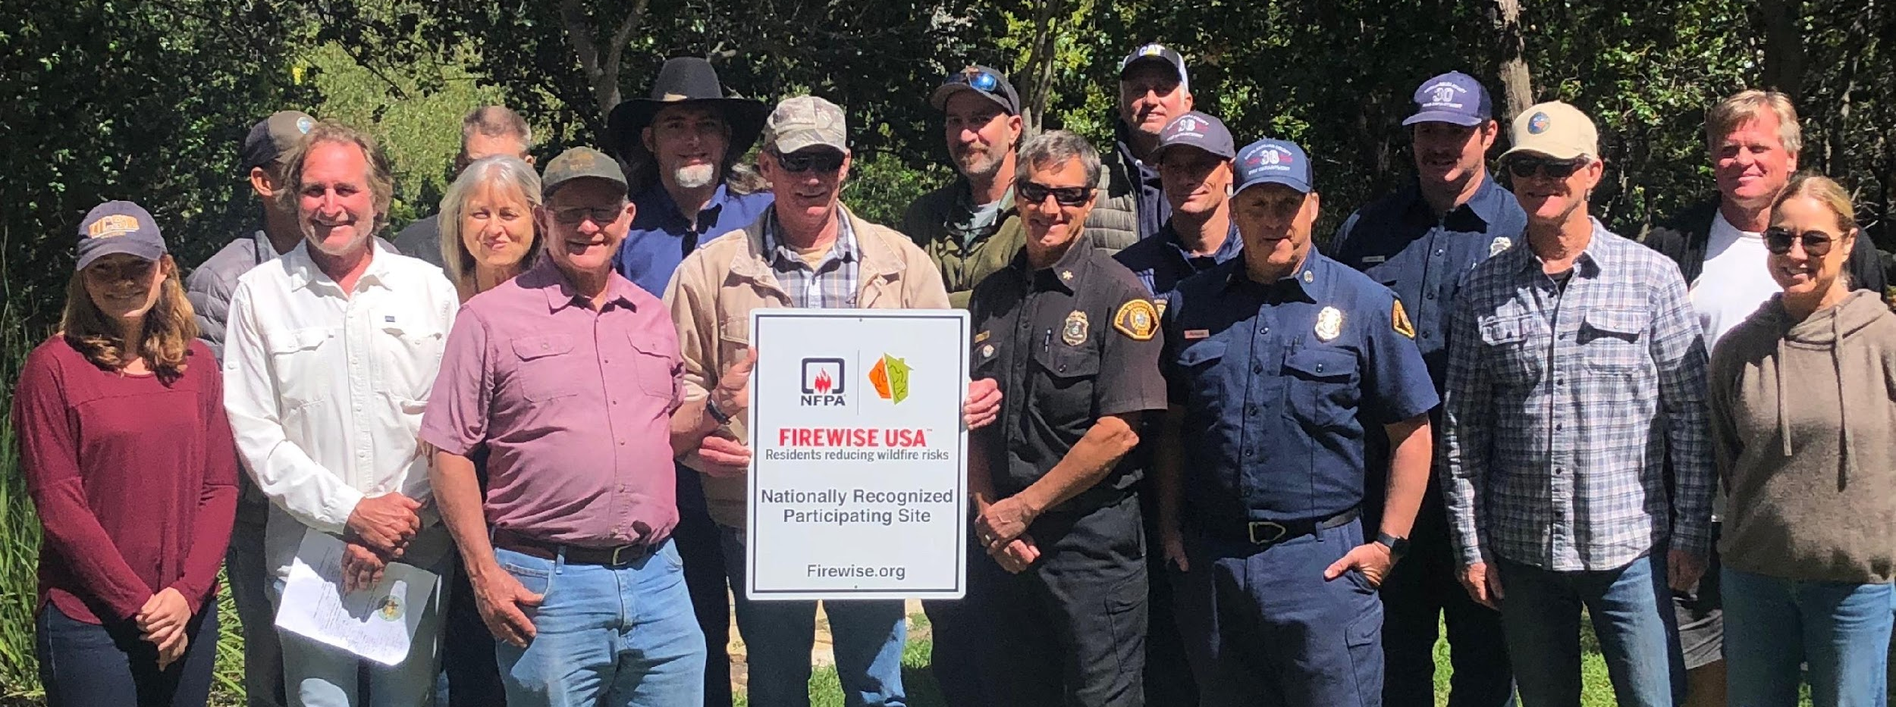
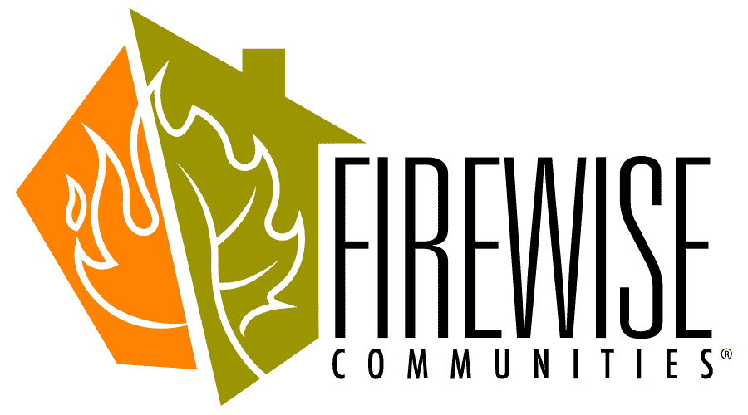
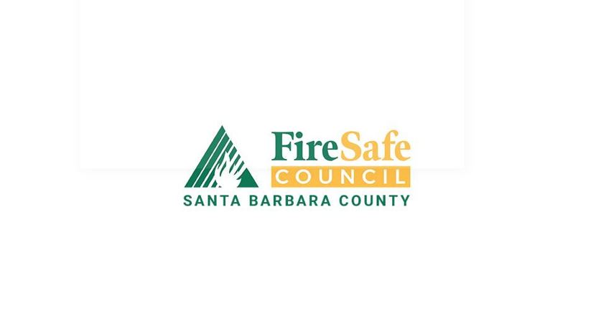
Firewise USA®
Kate Furlong
SB County Fire Safe Council
Community Wildfire Resilience Project Manager

Slide 2

What is Firewise?
Free & voluntary program
Run by National Fire Protection Association (NFPA)
Provides a collaborative framework to help neighbors:
get organized,
find direction,
and take action to decrease wildfire risk of their homes and community.
NO regulation enforcement!
Notes:
FW= program from NFPA, it is not run by the SBFSC, we just encourage communities to use it.

Slide 3
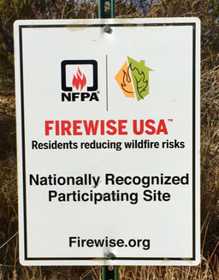
Benefits of a Firewise Community
Increase wildfire knowledge
Strengthen community connectedness
Increased grant appeal
Prioritization for future SBC FSC funds
Insurance benefits
USAA
Mercury
State Farm
CA Fair Plan

Slide 4
Firewise Recognition Process Overview
Application Process
Maintaining Firewise Recognition
Organize: Create committee of residents + wildfire stakeholders
Plan:
ID site boundary
Conduct risk assessment
Develop action plan
Do:
Community Education
(1 activity/year)
Homeowner Volunteer Hours (1 hour/household or ~$27/household))

Slide 5
Firewise Recognition Process Overview
Application Process
Maintaining Firewise Recognition
Organize: Create committee of residents + wildfire stakeholders
Plan:
ID site boundary
Conduct risk assessment
Develop 3-year action plan
Do:
Community Education (1 activity/year)
Homeowner Volunteer Hours (1 hour/household or ~$27/household))

Slide 6
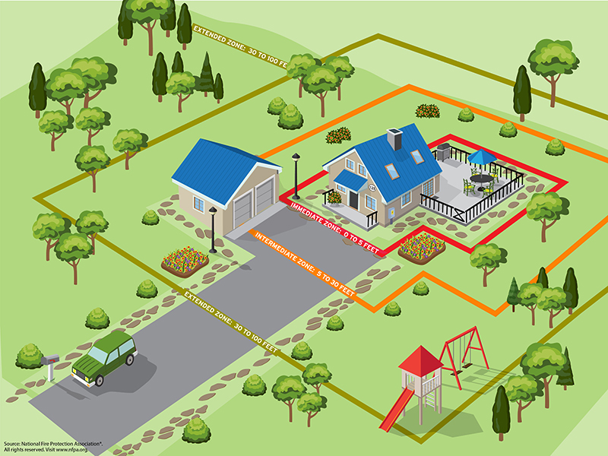
Risk Assessment
Home risk - Home ignition zone (HIZ)
% of homes with defensible space
% of homes with certain ignition resistant building materials (e.g., screens on vents, double pane windows, etc.)
Community level risk

Slide 7
3 Year Action Plan
Use risk assessment + other known community risks
Realistic goals
Suggested Topics:
Defensible space and structure retrofits
Evacuation planning and training
Apply for funding
Host education events (e.g., with firefighters, SB Office of Emergency Management)
Host community workday events
Work with partners on community vegetation buffer

Slide 8
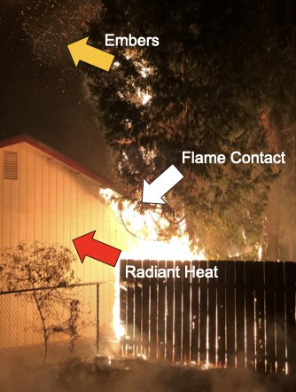
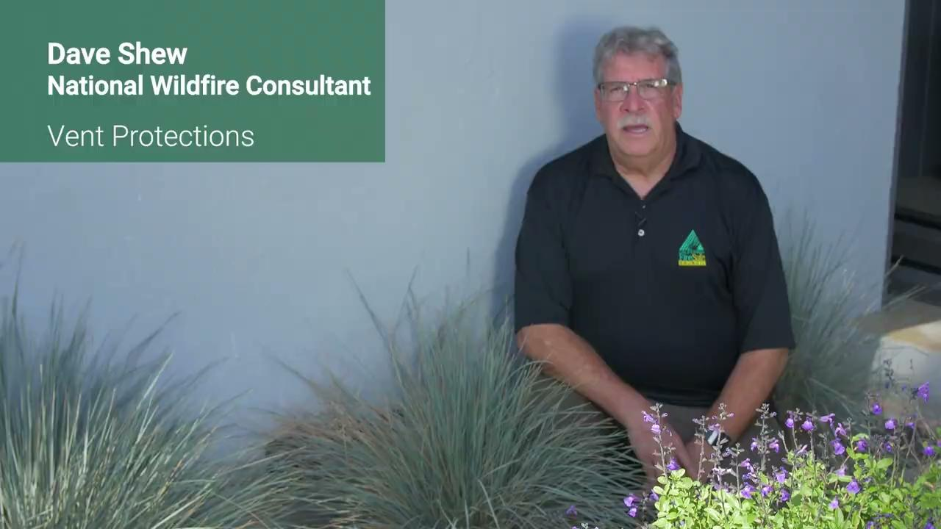
Standard Home Hardening Recommendations
IBHS Fence Video
Reduce vent mesh size to 1/8th inch screening
Dual-paned windows with at least one pane of tempered glass
Keep roofs and gutters clean and clear of debris

Slide 9
Defensible Space Recommendations
Combustible Free Zone Zero
Trim Trees at least 10 ft away from chimney outlets
Remove hazardous and highly flammable vegetation: Italian Cypress, juniper, Rosemary, Mexican Fan Palms, pampas grass, Oleander, bougainvillea and any vines growing on structures.
Helpful tip: If it is dry inside and accumulates dead material, it is highly flammable

Slide 10
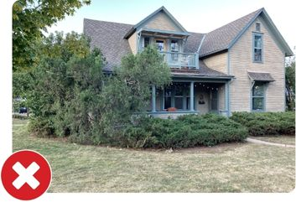
Defensible Space Recommendations
Junipers are highly combustible plants due to their volatile oils, dense growth, and retention of dead plant material.
Having juniper bushes near your home increases the likelihood it will be impacted by wildfire.
Junipers collect dead leaves and trash.
Junipers and trapped debris burn hot and fast.
Junipers give off large flames and generate abundant embers.
Junipers were a favorite foundation plant for many decades. Over time, what were once small discrete plants have often grown together to form a continuous wall of volatile vegetation.
The trapped needles and debris beneath make these plants highly susceptible to ember ignition. This is not the ideal plant to have in close proximity to your home!

Slide 11
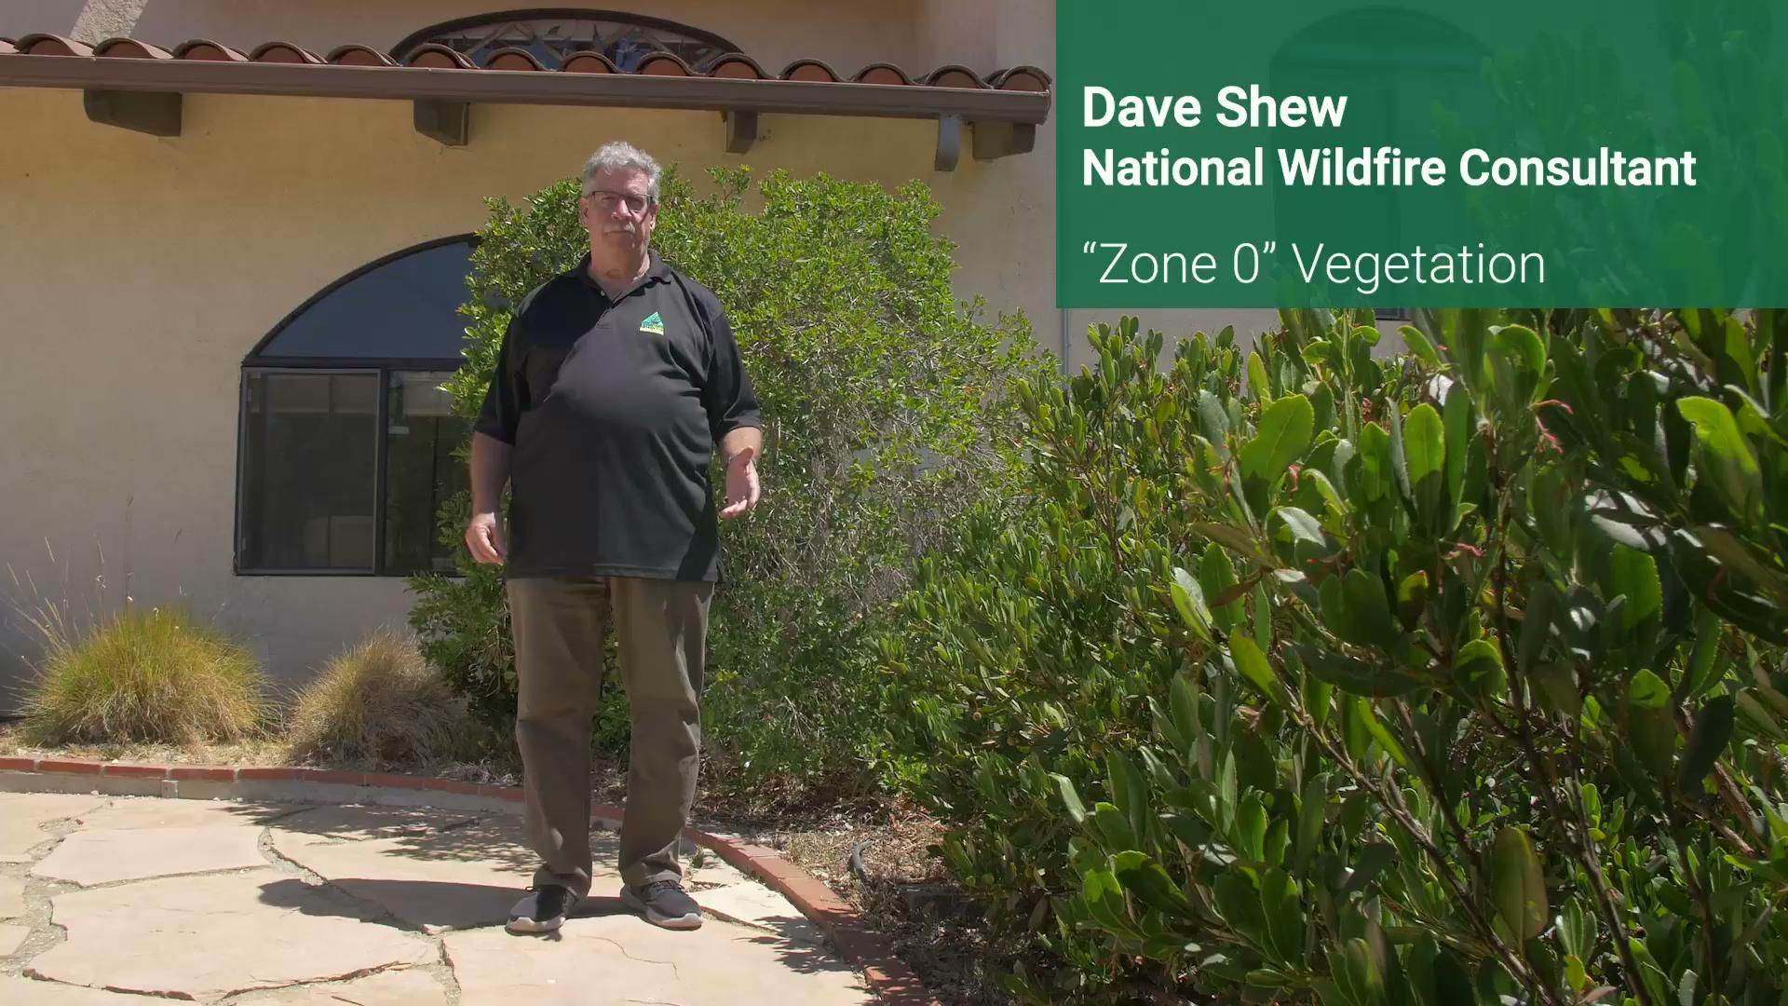

Slide 12
Firewise Recognition Process Overview
Application Process
Maintaining Firewise Recognition
Organize: Create committee of residents + wildfire stakeholders
Plan:
ID site boundary
Conduct risk assessment
Develop action plan
Do:
Community Education (1 activity/year)
Homeowner Volunteer Hours (1 hour/household)
Report quantity of vegetation removed
(NO minimum)

Slide 13
Volunteer and Education Requirements
1 hour (or $33.49 equivalent) per household per year
Examples:
HOA fees and community organization fees
Yard work: Raking leaves, clear gutters, cutting dead branches
Landscaping costs
Evacuation training
Home hardening expenditures
Coordination with FD or arborist
County time and resources (e.g., county supplies a chipper and chipper crew)

Slide 14
Firewise Recognition Process Overview
Application Process
Maintaining Firewise Recognition
Organize: Create committee of residents + wildfire stakeholders
Plan:
ID site boundary
Conduct risk assessment
Develop action plan
Do:
Community Education (1 activity/year)
Homeowner Volunteer Hours (1 hour/household)
Report quantity of vegetation removed
(NO minimum)
Annually: record and report education activities, volunteer hours, and vegetation removed
Every 3 years: Update action plan
Every 5 years: Redo risk assessment

Slide 15
Firewise Time Commitment
Committee Members
Non-committee Members
Application process (once)
Organize community events
Track volunteer hours
Annual renewals
Take lead on accomplishing Action Plan items
Volunteer 1 hour per year
Minimum 1 hour/household/year
Report volunteer hours and vegetation removed from property

Slide 16
SBFSC Involvement
Work hours: M-F, occasional work on weekends to attend community events
Assist with the Application process and help communities maintain their recognition
Grants:
What we can do: manage and oversee grants for Firewise communities
ie: Chipping program
What we cannot do: apply for grants just for 1-2 communities, apply for grants that only/primarily occur on private property (exception: low-income households and communities)
Host monthly meetings to connect with other Firewise communities

Slide 17
Contact Us!
Kate Furlong
Kfurlong@SBFireSafeCouncil.org
Charles Harris
Charris@SBFireSafeCouncil.org

